Slide 1
Lit Elements pt 5 – Lifecycle hooks
Encapsulated, single-responsibility, reusable code

Slide 2

Contents
Are the different from web component’s LH?
Which are added?
Which should you not touch?

Slide 3
Lifecycle hooks Lit vs. WC
Lit components use the standard custom element lifecycle methods.
In addition Lit introduces a reactive update cycle that renders changes to DOM when reactive properties change.

Slide 4
Standard Lifecycle hooks
Called when the object is created
We have already seen and used several lifecycle functions
constructor()
connectedCallback()
disconnectedCallback()
attributeChangedCallBack()
observedAttributes()
Called when the object is added to the DOM
Called when the object is removed from the DOM
Called when an ‘observed’ attribute changes value
Called when the object is added to the DOM

Slide 5
constructor (lit vs. WC)
Pretty much the same function
Always call super()
Initialize variables

Slide 6
connectedCallback (lit vs WC)
WC
attach the shadow root
attach styling
install event listeners
manually call the render function
Lit
(possibly) install additional event listeners

Slide 7
attributeChangedCallBack() lit vs WC
WC
Mannually check changes
Manually call redner function
Lit
Rarely needed at all
Handled by properties & convertors

Slide 8
observedAttributes() lit vs WC
Not needed in Lit
Covered by get properties() function

Slide 9
Lit reactive update cycle
In addition to the standard custom element lifecycle, Lit components also implement a reactive update cycle.
The reactive update cycle is triggered when a reactive property changes or when the requestUpdate() method is explicitly called.
Lit performs updates asynchronously

Slide 10
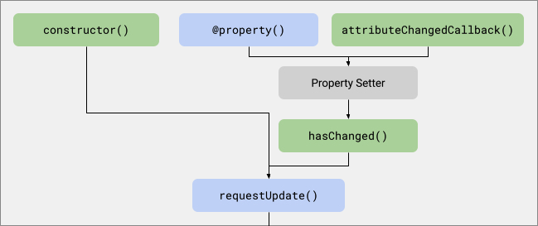
pre-update
An update is scheduled when one or more properties change or when requestUpdate() is called.

Slide 11
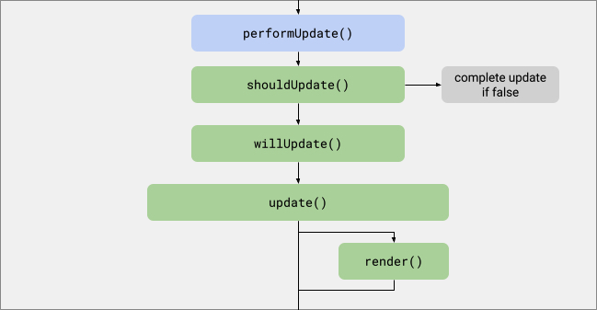
update
The update is performed prior to the next frame being painted.
Reflecting attributes are set.
The component’s render method is called to update its internal DOM.

Slide 12

Post-update
The update is completed and the updateComplete promise is resolved.

Slide 13
Triggering an update
An update is triggered when a reactive property changes or the requestUpdate() method is called.
hasChanged()
Called when a reactive property is set. By default hasChanged() does a strict equality check and if it returns true, an update is scheduled.
requestUpdate()
Call requestUpdate() to schedule an explicit update.
This may not always be what you want…
This be called from a time based event for example

Slide 14
Documentatie
Lit website:
https://lit.dev/docs/components/lifecycle/

Slide 15
Conclusion
The render() function is called whenever observed properties change.
The render function returns an html template.
You can use class.properties in the render function.
You can define event listeners in the render function.
You can expose selected css elements to the outside

